Slide 1

Songs Hit Prediction
B-Tech Project Presentation
Mentor : Dr. Shampa Chakraverty
Submitted By:
Payal Goel (302/CO/11)
Pramit Mallick (306/CO/11)
Rahul Duggal (311/CO/11)

Slide 2
Outline
Motivation
Previous Works
Objective
Our Contribution
Experiments and Results
Conclusion
Future Work

Slide 3
Motivation
Why songs hit prediction is important?
To benefit Record Companies before releasing their songs.
What exactly was the reason that fuelled the Beatles’ or any other band rise to fame?
Is there any Intrinsic quality in music that predisposes it to greatness?

Slide 4
Previous Works
Dhanaraj and logan [1] explored the use of support vector machine (SVM) and boosting classifiers to distinguish top 10 hits from other songs in various styles based on acoustic and Lyric- based features.
.Pachet and Roy [2] tried to develop an accurate classification model for low, medium or high popularity based on acoustic and human features but were unsuccessful.
The experiment by Ni.et.al. [3] has more optimistic results when predicting if a song would reach a top 5 position on the UK top 40 singles chart compared to top 30-40 position.
Herremans.et.al [8] focuses on predicting whether a song is a “top 10” dance hit versus a lower listed position using SVM classifier.

Slide 5
Objective
To find all the features that distinguish a Hit song from a non-hit one.
Using the set of features, we aim to classify any given new song as a potential hit or not by using the following classifiers
Linear Regression
Logistic Regression
Support Vector Machines
To find the best classifier with high rate of accuracy to make a prediction.

Slide 6
Our Approach
For Audio features, we used an product API called EchoNest
For Lyrical features, we used a novel approach of emotion classification using Parrott’s hierarchy.

Slide 7
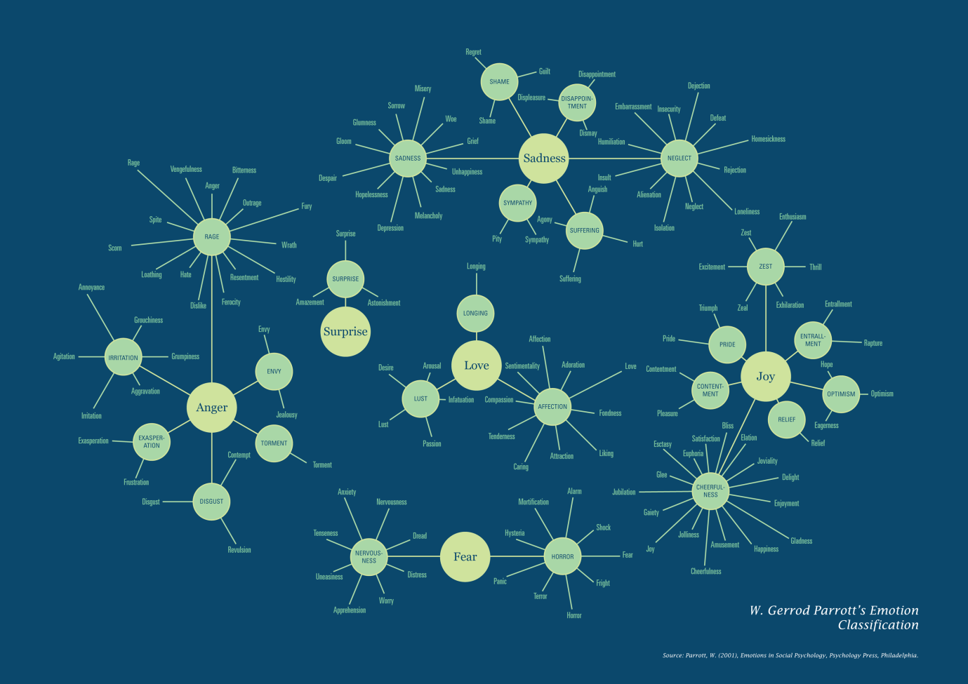
Parrott’s Emotion Classification

Slide 8
Dataset
Dataset Collection
Songs Collection
Pre-processing
Feature Collection

Slide 9
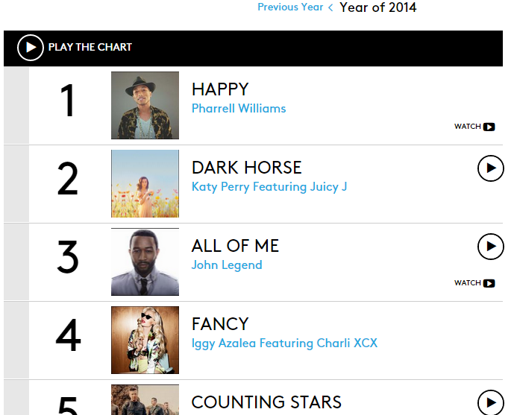
Song Collection
Dataset(Cont.)
We have taken the dataset from billboards.com
Billboard Year-End charts are a cumulative measure of a single or album’s performance in the United States. Year-end charts were calculated by an inverse-point system based solely on a title's performance. Other factors including the total weeks a song spent on the chart and at its peak position were calculated into its year-end total.

Slide 10
Dataset(Cont.)
Extracting audio features using Echonest API
Following features are found for each song using the EchoNest API :
Acousticness, danceability, etc.

Slide 11
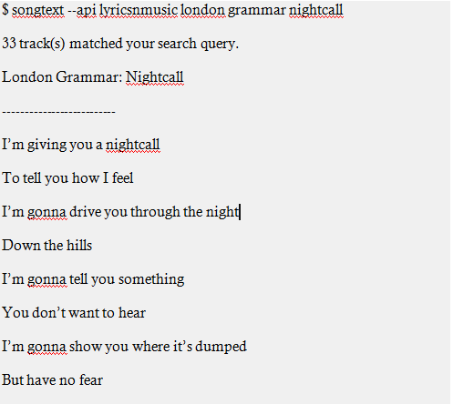
Dataset(Cont.)
Extracting Lyrics using python package ‘songtext-0.1.3’ and its LyricsWiki API

Slide 12
Dataset(Cont.)
Next we calculated and ranked all the words of all the songs by its TF-IDF (There are 100 songs in a year).
We used Latent Semantic Analysis and inputs form WordNet to give a measure of similarity between two words.
Find the similarity index of top 20 words (according to TF-IDF) with the 6 primary emotions of Parrot’s Emotion Classification.
Add the above similarity index multiplied by the TF-IDF to the corresponding emotion in emotion vector.

Slide 13
Dataset(Cont.)
Ex – Suppose a song has the word ‘lover’ in it and the emotion vector of the song be assumed to be [0,0,0,0,0,0] (0-for each of the emotions love, joy, sadness, anger, surprise, fear)
‘lover’ gives the following degrees of similarities with the primary emotions:
Lover-Love 0.7506343
Lover-Joy 0.17573524
Lover-Sadness 0.040953867
Lover-Anger 0.013633692
Lover-Surprise 0.06152932
Lover-Fear 0.09170411
So, here we see that ‘lover’ gives maximum similarity with the emotion Love, so we multiply 0.7506343 with ‘lover’ ‘s TF-IDF (say 0.1) and add it to the emotion vector.
So, the emotion vector becomes [0.07506343,0,0,0,0,0]
This way, we calculate the emotion vector for each of the songs
Maximum Similarity

Slide 14
Dataset(Cont.)
Now, we are ready with our final dataset i.e. songs with 17 features containing both acoustic and lyrical as well.
'song_rank','acousticness','danceability','duration','energy','key','liveness','loudness','mode','speechiness','time_signature','valence','love','joy','surprise','anger','sadness','fear'.

Slide 15
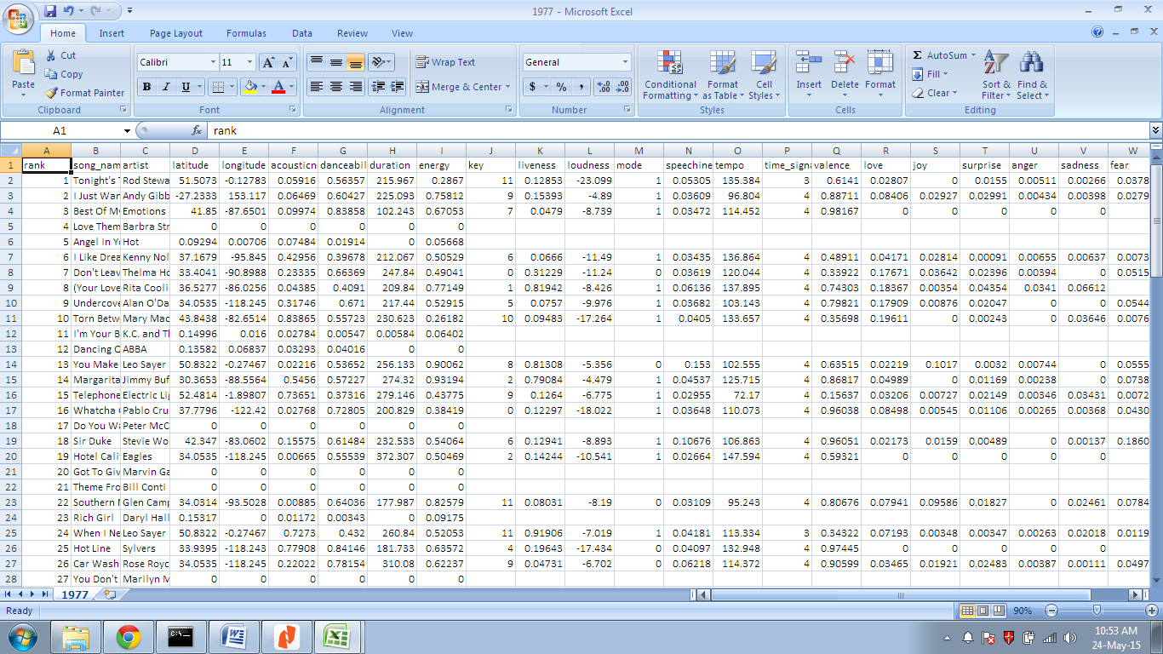
Final usable dataset

Slide 16
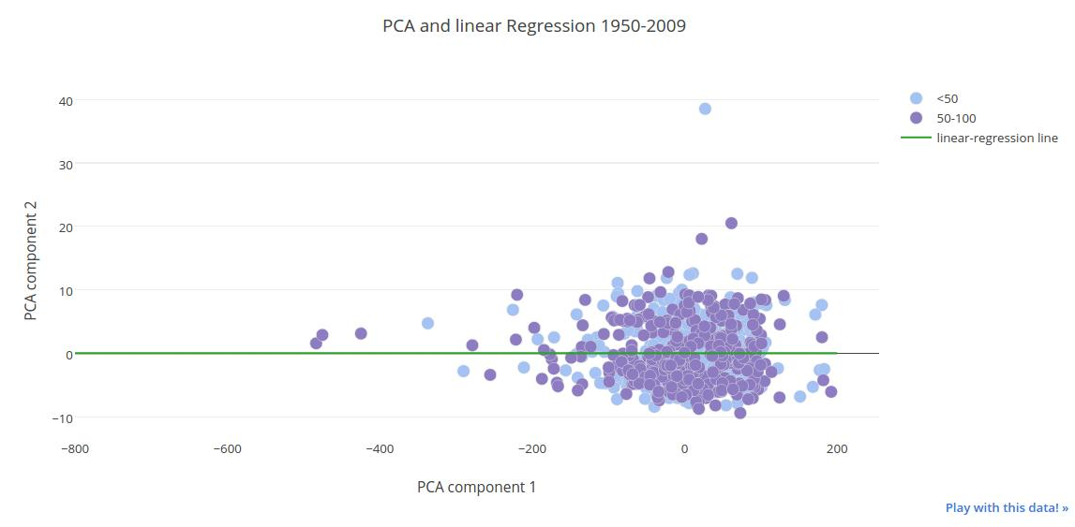
Applying Classifiers:
To have a visual intuition, we attempt to reduce the number of features from 17 to 2 using PCA (Principle Component Analysis)

Slide 17
PCA (contd.)
As we were not able to visually locate a clear dividing line among the classes in the dataset, we discard this approach.
Hence, we take the entire 17 features vectors into account instead of reduced features.

Slide 18
Initial run on The entire dataset
On running the classifiers on the entire dataset from 1950-2010, we obtained the following results.
We can see all the classifiers have performed poorly. This is because we have not considered any temporal dependecy to the ranks
 | Audio Only | Lyrics Only | Audio+Lyrics
Linear | 0.513788098694 | 0.503628447025 | 0.510885341074
Logistic | 0.515239477504 | 0.502177068215 | 0.502177068215
SVM | 0.505079825835 | 0.518142235123 | 0.500725689405

Slide 19

Applying Classifiers: Linear regression
Using linear regression we get the prediction for the test data and we take a threshold value of 0.5, i.e. if the prediction of the value is <0.5, then we classify it as Class 0 otherwise Class 1.
Accuracy Percentage =
The maximum accuracy obtained on any decade was in 2000-2010, when it was 58% while considering lyrics only.

Slide 20
Applying Classifiers: Logistic regression
The logistic classifier returns the probability that the test sample belongs to class 1. If it is > 0.5, then we say it is class 1 else in class 0.
The maximum accuracy obtained using this classifier was 0.57857 obtained for 1980-90 decade using audio and lyrics features.

Slide 21
Applying Classifiers: Support Vector Machines
The SVM classifies data points by dividing the training data into a set of hyperplanes while maximizing the distance to the nearest training data point of any class.
The maximum accuracy obtained was 0.6 obtained for the 1960-70 decade using audio as well as lyric features.

Slide 22
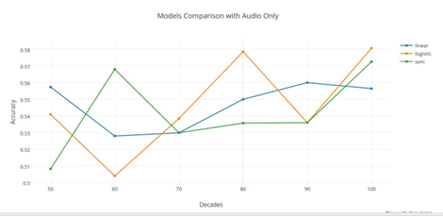
Some Comparisons
Using Audio Features Only:
Notice the drop in accuracy in the 1980-90 decade.
Note The height

Slide 23
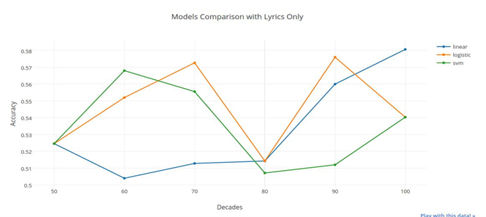
Some Comparisons
Using Lyric Features Only:
Note The drop

Slide 24
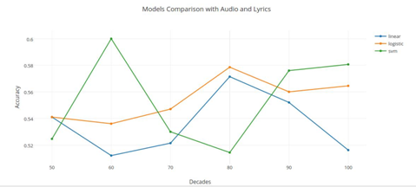
Some Comparisons
Using Lyric + Audio Features:
Height cancel led the drop

Slide 25
Inferences
We can clearly see in the case of SVM classifier, the height cancelled the drop for the 1980-90 decade.
So we can say the logistic regression classifier got more robust if we consider both the audio as well as lyric features.
The same cannot be said in case of other classifiers, which have many fluctuations from decade to decade.

Slide 26
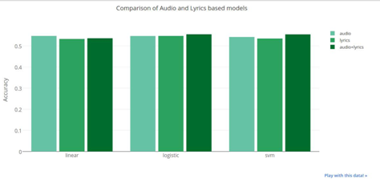
Analysis of accuracy of classifiers using audio and lyric features
In this plot, we consider the average accuracies of each of the decades.
The linear model doesn’t show any improvement, but the logistic and SVM models show improvement when we include both the audio and lyrical features.

Slide 27
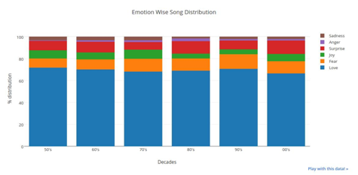
Emotion Analysis
We plot the degrees of emotional quotient of each of the primary emotions i.e. Love/Joy/Surprise/anger/sadness/fear, in each of the decade.
As we expected, the most sung-about emotion is ‘Love’ followed by either ‘Surprise’ or ‘Fear’

Slide 28
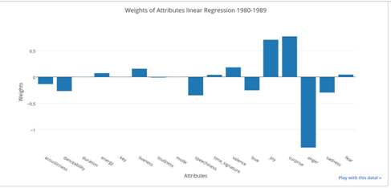
Features Analysis
The weights of the features of the trained Linear Regression model give us some clues.
we see that anger is the one emotion and feature that contributes the most towards prediction but also make the song unpopular.
Surprise has maximum positive weight thus mainly responsible for popularity.

Slide 29
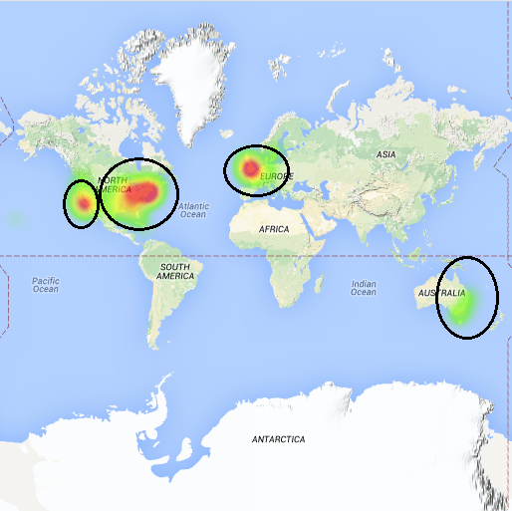
Some other analysis
Plot the artist location on a heatmap to identify the location from where most of the hit songs originate.
Circles in image given in previous slide shows that majority of artists belongs to areas like east and west coast of USA, United Kingdom and Eastern coast of Australia.

Slide 30
Some other analysis(Cont.)
Analysis done using K-means Clustering
We classify the songs into clusters on the basis of its acoustic features and analyze its results. Experimentation, we used 7 clusters centroids
These clusters correspond to various genres of music as the it can be assumed with little margin of error that music of a genre must have similar acoustic features.

Slide 31
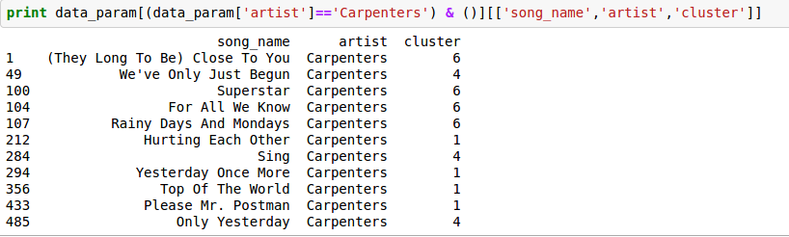
Some other analysis(Cont.)
In the above figure, it is seen that all of the songs by ‘Carpenters’ can be classified only in three categories.
This confirms the notion that a particular artist usually makes music specific to certain genres mostly.

Slide 32
Conclusion
We found that the combination of both audio & lyrical features provides us with a more robust metric for prediction than their individual contributions.
Though the SVM model gave the highest accuracy in a particular decade, the Logistic Regression gave the most consistent prediction.

Slide 33
Improvements & Future Work
We can use the entire hierarchy of Parrott’s emotion classification for emotional analysis.
We can use a better scientific temporal division for predictions than the decade-wise analysis.
The locations of the artists could also be considered as parameters to the model.
One could also mine cultural and social emotions from news, social media to see if it impacts the short term ranking of a song.

Slide 34
References
[1] R. Dhanaraj and B. Logan. Automatic prediction of hit songs. In Proceedings of the International Conference on Music Information Retrieval, pages 488{91, 2005.
[2] F. Pachet and P. Roy. Hit song science is not yet a science. In Proc. of the 9th International Conference on Music Information Retrieval (ISMIR 2008), pages 355{360, 2008.
[3] Ni, Y., Santos-Rodriguez, R., Mcvicar, M., & De Bie, T.: The T Hit Song Science Once Again a Science? In: 4th International Workshop on Machine Learning and Music Learning from Musical Structure, (2011)
[4] C. Burges. A Tutorial on Support Vector Machines for Pattern Recognition. Data Mining and Knowledge Discovery, 2(2):121–167, 1998.
[5] B. Logan, A. Kositsky, and P. Moreno. Semantic analysis of song lyrics. In ICME 2004,
[6] G. Tzanetakis and P. Cook. Musical genre classifation of audio signals. Speech and Audio Processing, IEEE transactions on, 10(5):293{302, 2002.
[7] T. Jehan and D. DesRoches. EchoNest Analyzer Documentation, 2012. URL developer.echonest.com/docs/v4/_static/AnalyzeDocumentation.pdf.
[8] D. Herremans, K. Sorensen, and D. Martens. Classi_cation and generation of composer speci_c music. Working paper - University of Antwerp, 2013.
[9] van Zaanen, Menno; Kanters, P.H.M Automatic mood classification using tf*idf based on lyrics. 11th International Society for Music Information Retrieval Conference (ISMIR 2010)
[10] Lushan Han, Abhay Kashyap, Tim Finin, James Mayfield and JonathanWeese. UMBC EBIQUITY-CORE: Semantic Textual Similarity Systems.
[11] http://msaprilshowers.com/emotions/parrotts-classification-of-emotions-chart/attachment/parrotts-chart-of-emotions/
[12] http://www.billboard.com/charts/year-end/2014/hot-100-songs

Slide 35
Thank You

